Slide 1
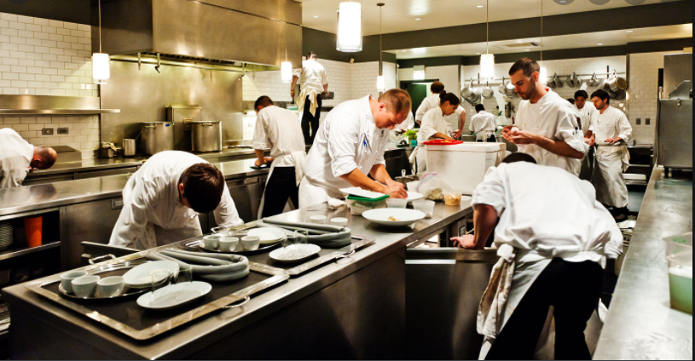
Appetite Training for Restaurants
Presented by: Diantha Kelly & Gayane Karamanukyan

Slide 2
Agenda
Restaurant & Bar Appetite Training
Class Codes
Premium Threshold
Class Ops Questions
In Appetite
Out of Appetite
Association & discounts

Slide 3
Straight Through Quotes Premiums
All Target Classes state premium are eligible for “Straight-Through-Quoting

Slide 4
Class Ops Questions
DOES the Applicant: | This question must be answered if there is a FOODSRV industry class code present.
• Deliver
• Provide off-premises catering
• Operate a mobile catering service
DOES the Applicant exclusively use a 3rd party for ALL delivery services (i.e. GrubHub, Uber Eats, etc). | This question must be answered if EMPCO-3009 is YES.
DOES the Applicant: | This question must be answered if EMPCO-3109 is NO.
• Use a motorcycle, scooter or bicycle.
• Make deliveries past 11:00 PM
• Have delivery that exceeds a 10 miles radius.
• Have delivery receipts that exceed 60% of total sales.
• Have drivers under 19 years of age
• NOT have a distracted driving policy in place

Slide 5
Class Codes
NCCI States
9082-RESTAURANT NOC
9083-RESTAURANT: FAST FOOD.
9084-BAR, DISCOTHEQUE, LOUNGE, NIGHTCLUB OR TAVERN
CA, TX, NJ, MA
9079-RESTAURANTS OR TAVERNS - ALL EMPLOYEES
9078-SANDWICH SHOPS - NOT RESTAURANTS - N.O.C.
9079-05 TAVERNS - ALL EMPLOYEES - INCLUDING MUSICIANS AND ENTERTAINERS
Pennsylvania
0897-FAST-FOOD RESTAURANT
0975 -RESTAURANT, N.O.C.
0899-01-BAR, TAVERN, COCKTAIL LOUNGE, NIGHTCLUB OR DISCOTHEQUE - ALLEMPLOYEES EXCEPT OFFICE
0899-02-BAR

Slide 6
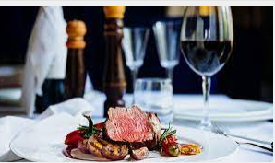
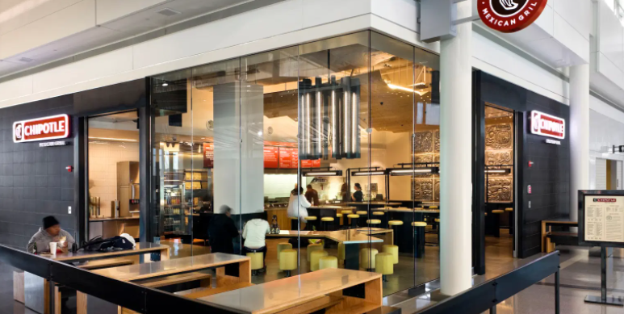
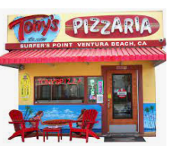
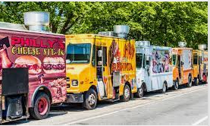
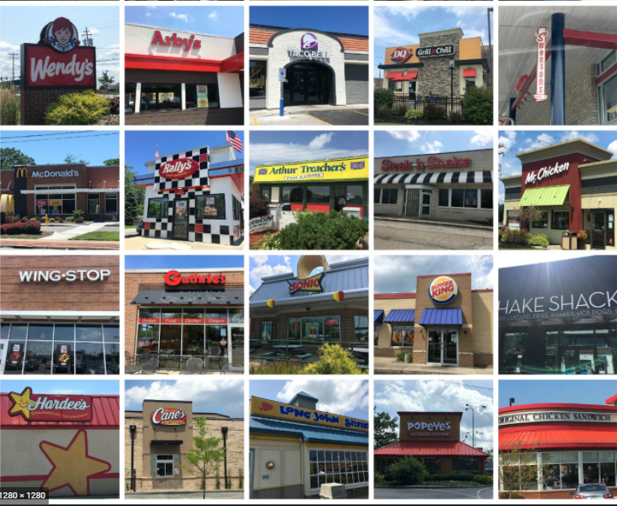
In Appetite
Quick Casual
Fine Dining
Pizza with some delivery
Food
Trucks
Fast Food
Family Style Dining-Apple Bees, Olive Garden, Chilis
Ice Cream & Frozen Yogurt Shops – Baskin Robbins
Sandwich Shops- Sub Way, Togo
Coffee/Beverage Shops
24 Hour -Denny’s, IHOP, Waffle House
Catering
Franchise & Non Franchise

Slide 7
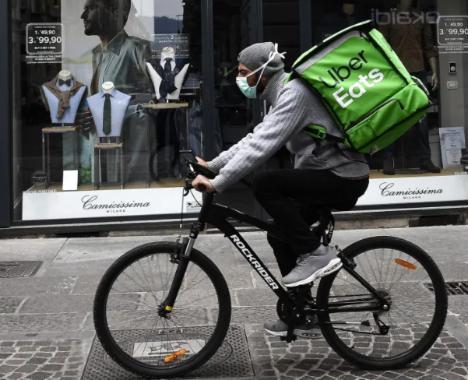
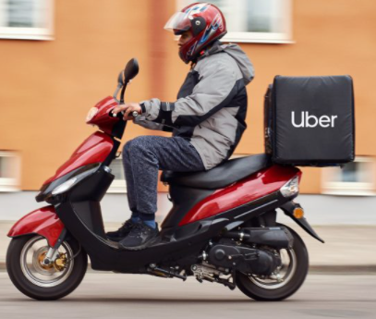
Out of Appetite
McDonalds
Bicycle, scooter, motorcycle,
skateboard delivery

Slide 8
Association Discounts
https://www.employers.com/employers-advantage/partnerships/

