Slide 1
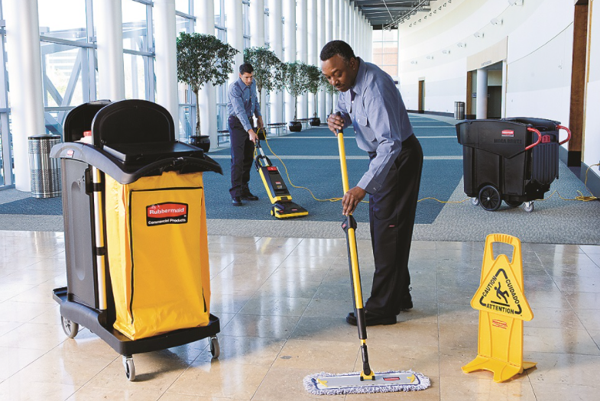
Appetite Training for Janitorial
Presented by: Diantha Kelly & Gayane Karamanukyan

Slide 2
Copyright © 2018 EMPLOYERS. All rights reserved.
This presentation may contain confidential, material, and/or non-public information regarding Employers Holdings, Inc. and its subsidiaries (“EMPLOYERS”). The United States securities laws prohibit any person who has received material, non-public information from an issuer from purchasing or selling securities of such issuer or from communicating such information to any other person under circumstances in which it is reasonably foreseeable that such person is likely to purchase or sell securities.
EMPLOYERS and America’s small business insurance specialist are registered trademarks of Employers Insurance Company of Nevada. Employers Holdings, Inc. is a holding company with subsidiaries that are specialty providers of workers' compensation insurance and services focused on select, small businesses engaged in low-to-medium hazard industries. The company, through its subsidiaries, operates in 37 states and the District of Columbia from 10 office locations. Insurance is offered through Employers Insurance Company of Nevada, Employers Compensation Insurance Company, Employers Preferred Insurance Company and Employers Assurance Company, all rated A- (Excellent) by the A.M. Best Company. Coverage is not available in all jurisdictions and varies by company. See www.employers.com for coverage availability.

Slide 3
Agenda
Janitorial Appetite Training
Class Codes
Premium Threshold
In Appetite
Out of Appetite
Qualifying Discounts
Questions

Slide 4
Premium Thresholds
Janitorial exposures are binary!
Under $7,500
Quote (STQ)
Decline
Over $7,500
Refer to UW
Decline

Slide 5
Class Codes
NCCI States
CA, TX, NJ, MA

Slide 6
Class Codes
Pennsylvania

Slide 7
Class Codes
Delaware

Slide 8
In Appetite
Commercial Janitorial
Office Cleaning
Residential Cleaning – Franchise only

Slide 9
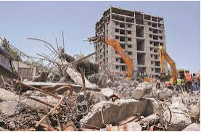
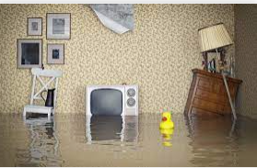
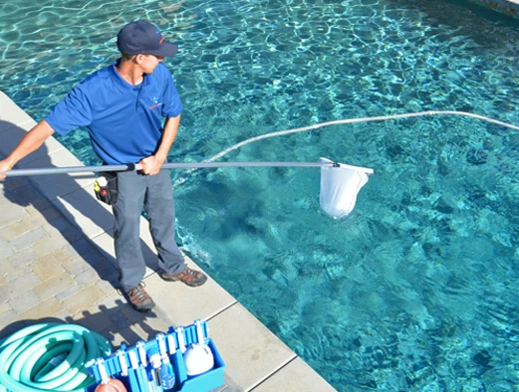
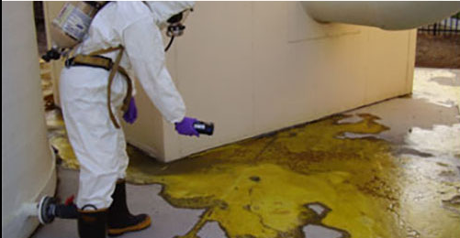
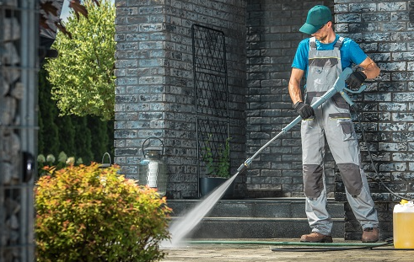
Out of Appetite
Construction Demolition
cleanup
Fire & flood restoration
Pool Cleaning
Hazardous waste cleanup
Pressure Washing
Hospital/Nursing home cleaning

Slide 10
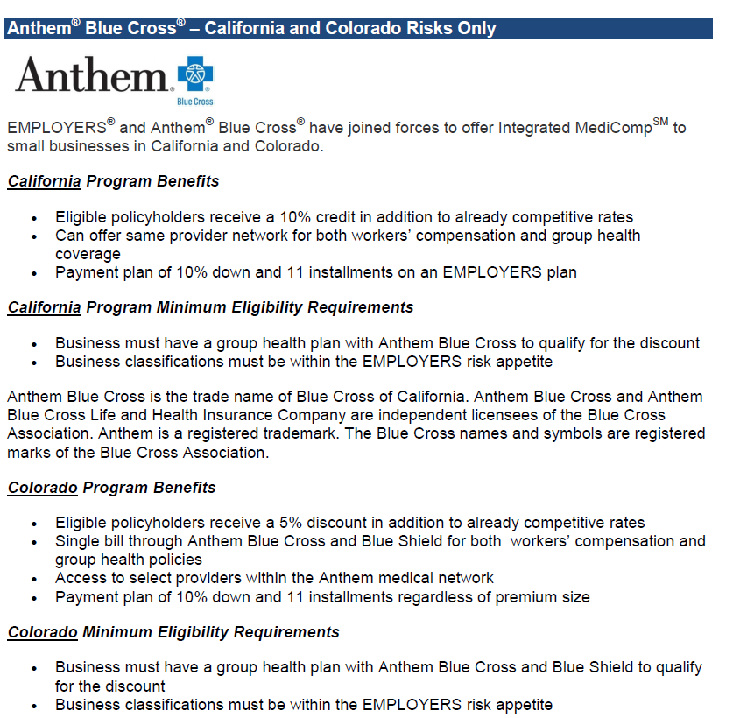
Discounts

Slide 11
Questions

